Slide 1


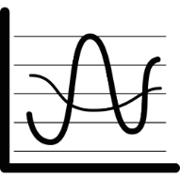
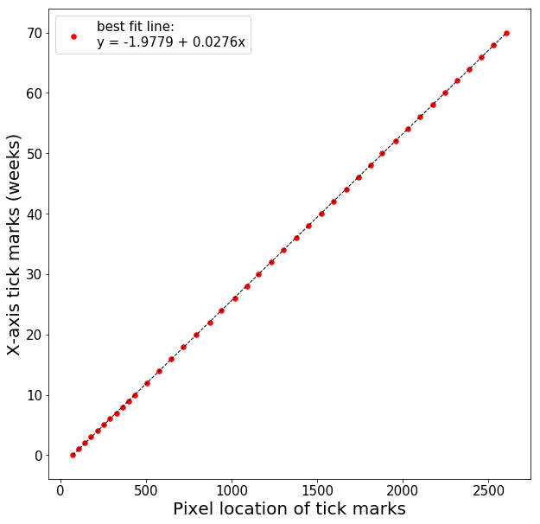
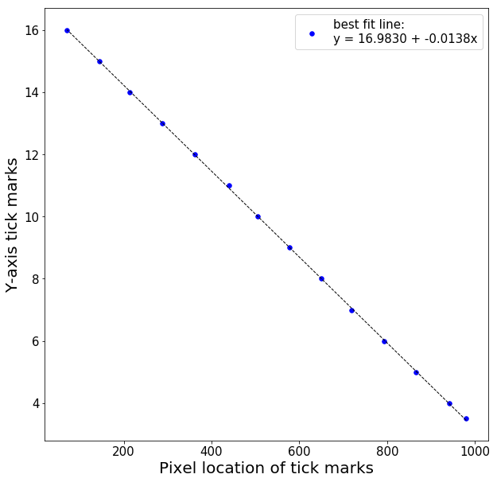
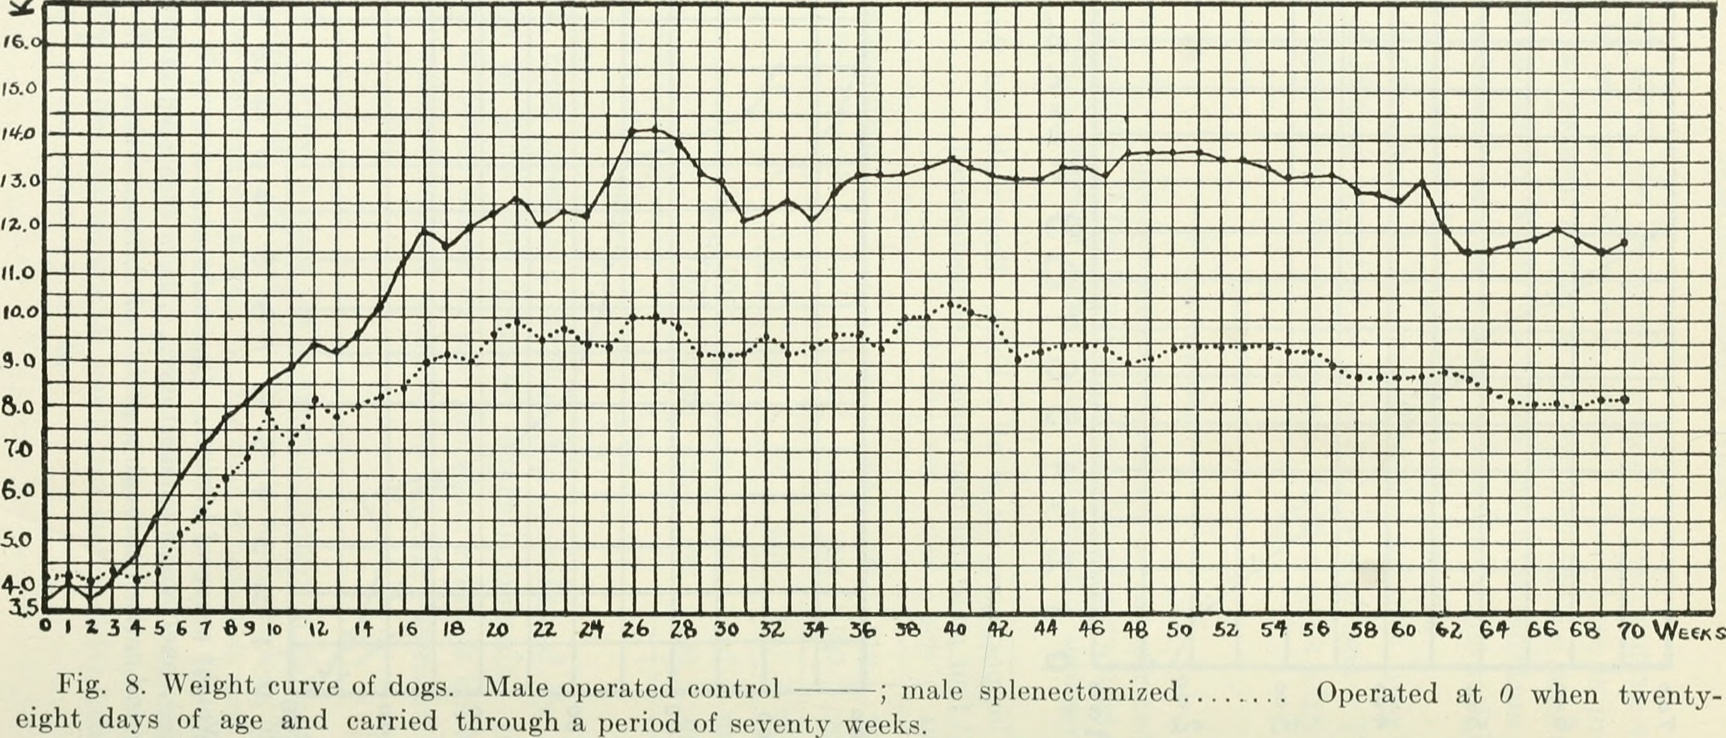
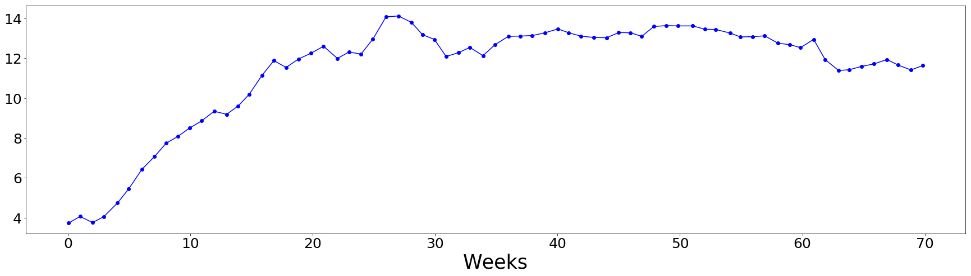
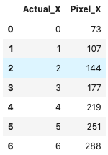
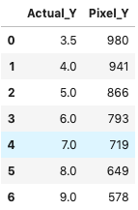
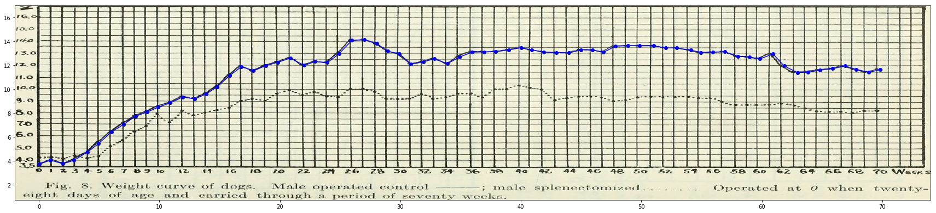
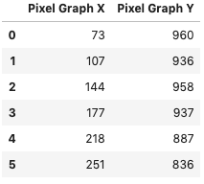
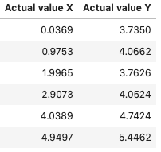

Activity 2: Practical Image Processing 2
Kenneth M. Leo
2015 – 13015
Applied Physics 186
OBJECTIVES
CALIBRATION CURVES
Convert pixel location of a graph into its corresponding physical value
Compare the original graph to the reconstructed graph by overlaying the two
These are the calibration curves used for the tick marks for x-axis (right) and the y-axis (left):
X-axis: actual_value = -1.9779 + 0.0276*pixel_loc (R-squared = 1)
Y-axis: actual_value = 16.9830 – 0.0138*pixel_loc (R-squared = 0.99)
GRAPH USED
Graph to reconstruct
Scanned graph of hand drawn plot used [1], x-axis is labeled in weeks while the y-axis is unlabeled
[1] The graph was taken from the American journal of physiology (1920)
RECONSTRUCTION OF GRAPH
HOW I TACKLED THE ACTIVITY
1. Measure pixel location of the coordinate system’s tick marks (both x- and y-axes) and tabulate the values
2. Make calibration curve for converting pixel location to its corresponding physical value
Reconstructed graph alone (top) and the reconstructed graph overlayed to the scanned graph
Comparing the scanned graph and my reconstructed graph, I can see that I did pretty accurate in converting the pixel location to the actual value. This is because the calibration curves that I got were linear with high R-squared values.
3. Tabulate pixel locations of some points on the graph and use calibration curve to convert into physical values
convert to
SELF - EVALUATION
Technical Correctness – 5
Quality of Presentation – 5
Initiative – 2 (integrated past lessons on 166 such as finding the calibration curve using Python)
4. Reconstruct the graph and compare it to the scanned graph by overlaying the two
Additional
Notes:
I used Python in creating the calibration curves and recreating the graph. Here is a link to a folder containing all the raw data I gathered and the notebook I used to process the data. http://tiny.cc/Activity2AP186

